Slide 1
Smart Electric Transit
Ryanne Cox, Matt Culbertson, Aarushi Singh

Slide 2
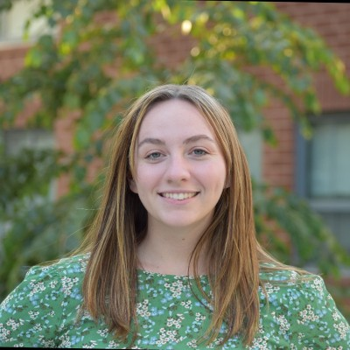
Ryanne Cox
Junior CSE Major
From Gorham, ME
For this project, Ryanne is working on the simulation

Slide 3
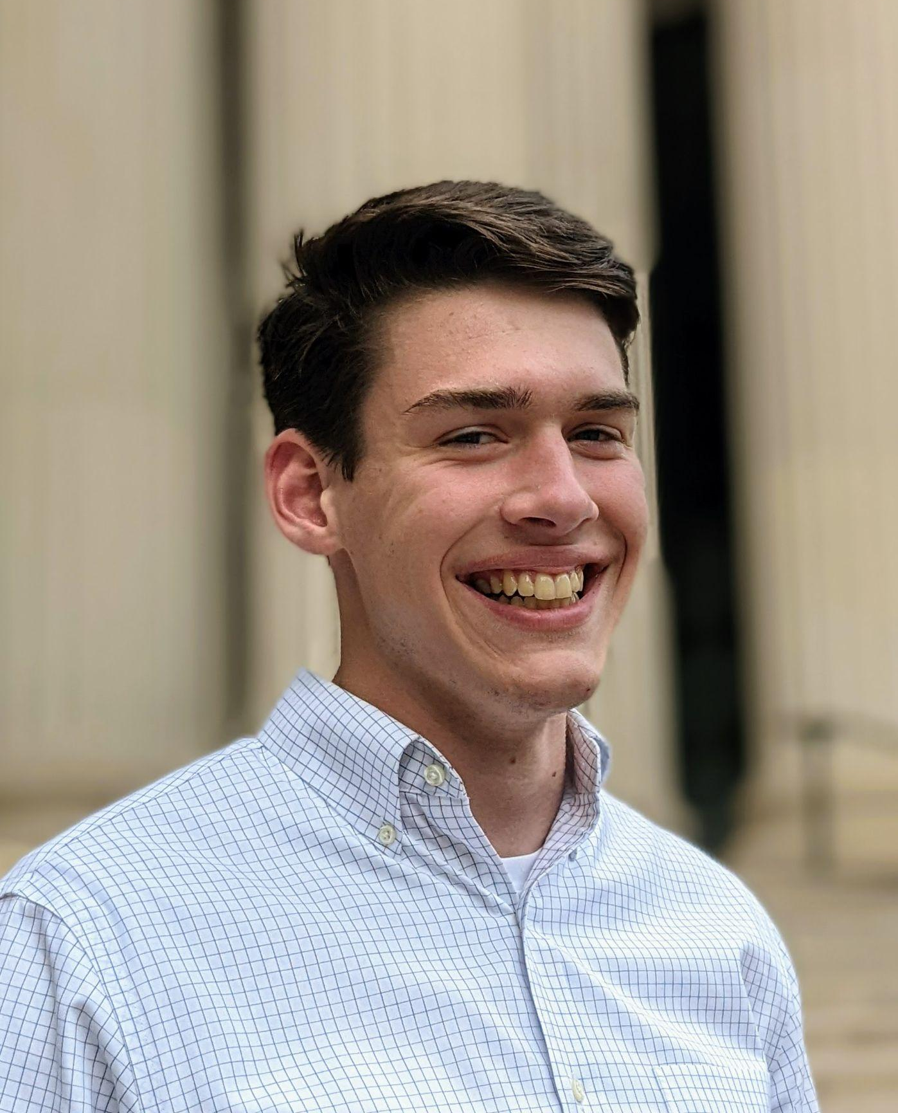
Matt Culbertson
Sophomore CSE Major
From Normal, IL
For this project, Matt is working on analyzing the data

Slide 4
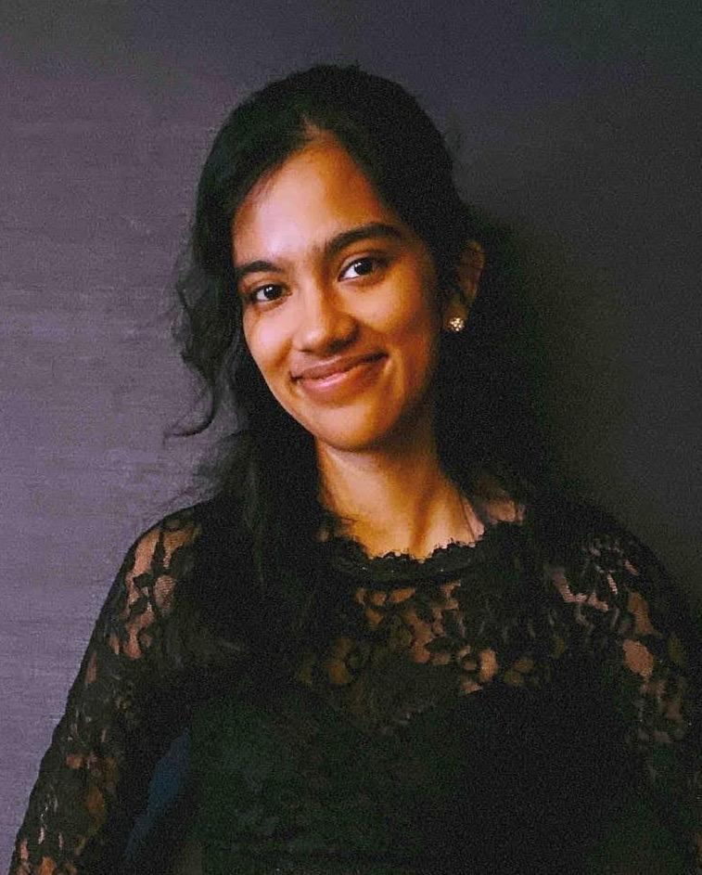
Aarushi Singh
Sophomore CSB Major
From Warrington, PA
For this project, Aarushi is working on analyzing the data

Slide 5
Project Overview
State of California mandate for zero-emissions public transportation bus fleets by 2040
The Valley Transit Authority (VTA) in Santa Clara has purchased ten electric buses
Team of faculty and students looking to optimize electric buses
Data analysis
Simulation/modeling
Continuing capstone project
Notes:
Currently they are modeling the transit routes in the area with SUMO software, however the platform does not support controlling the state of charge of the busses. Prior data analysis found on sparse data sets struggled to find a correlation between energy composition and weather, although it did determine that the driver has a large impact.

Slide 6
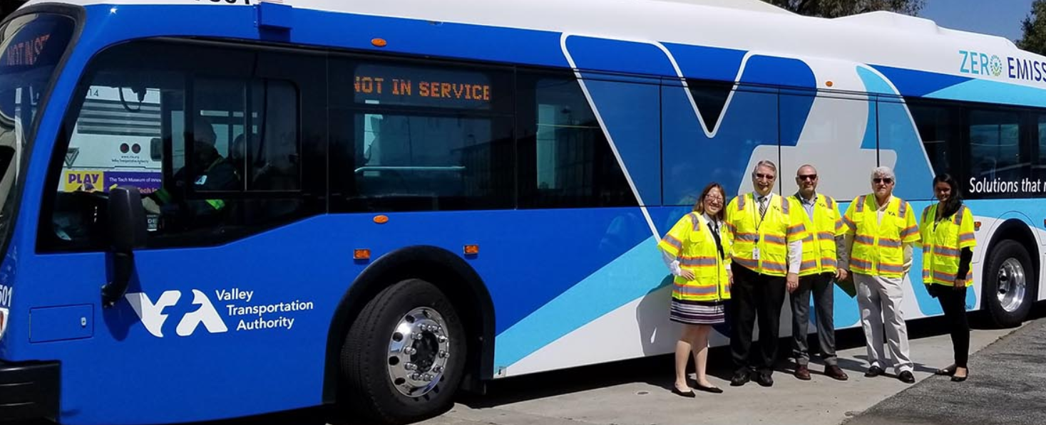
Project Overview
Photo: Prof. Kishore (far right) in California at the VTA source: https://alumni.lehigh.edu/news-blog/battery-powered-buses

Slide 7
Business Value/Motivation
VTA are testing with ten electric busses
Goal: charge the buses when electricity is cheapest while still meeting the community's needs
Strategy:
track and forecast how much energy buses are using
create a simulation of the bus route involving the charging station
The end goal for the VTA is to minimize energy and cost wastes.
Notes:
The Valley Transit Authority (VTA) needs to deploy a fleet of zero emission buses by 2040 in order to align with new state laws. Currently, they are testing with ten electric busses, but are unsure with how to best utilize them. Throughout the day, the cost of energy changes, so the VTA is seeking a way to charge the buses when electricity is cheapest while still meeting the community's needs. The strategy the VTA is following is to track and forecast how much energy buses are using and to create a simulation of the bus route involving the charging station. The end goal for the VTA is to minimize energy and cost wastes.

Slide 8
Project Management
Two halves for one whole :
Data analysis (Matt and Aarushi)
Analyzing data from the VTA and Viriciti and creating visual representations
Simulation (Ryanne)
Simulate the battery level of the buses when they return based on several variables
Tools used to organize work:
Trello
Scrums
Weekly sprint reports
Rotating group assignments
Notes:
As we mentioned in the project overview, our project is split into two halves. Matt and Aarushi are working on the data analysis. The goal of the data analysis is to discover what variables are having significant impact on the buses. I have been working on the simulation. The goal of the simulation is to create a stochastic simulation that can be used for optimizing things like scheduling. ** Discuss how we use our project management tools

Slide 9
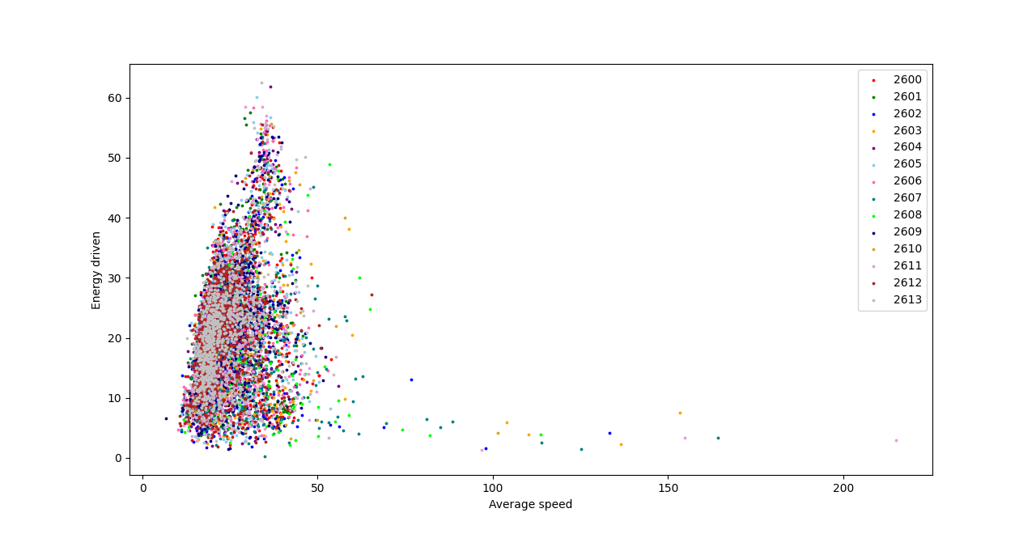
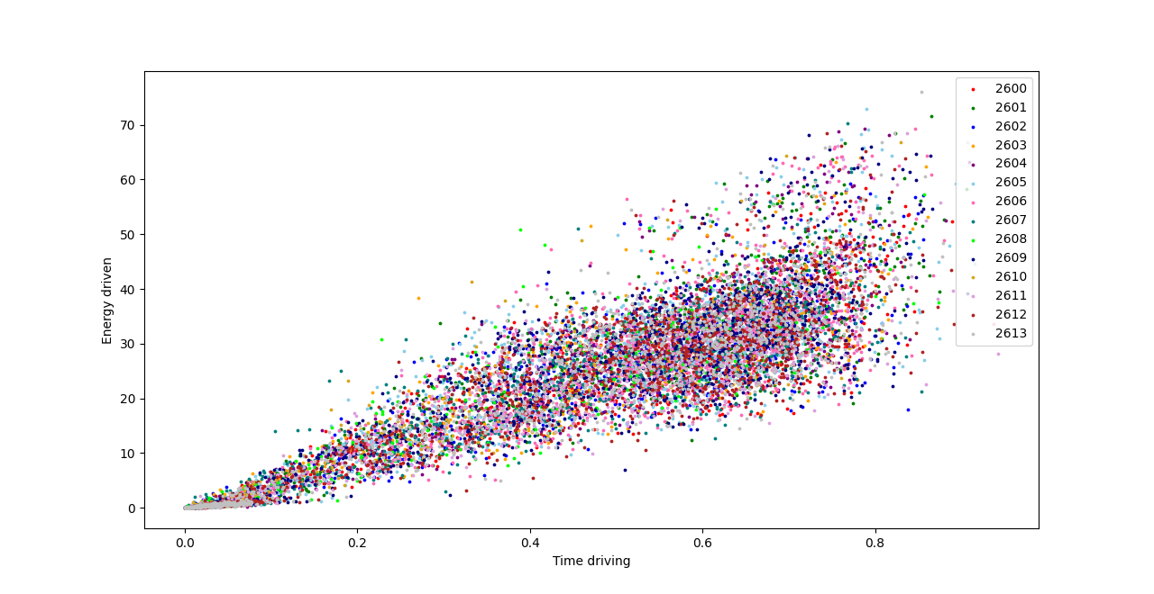
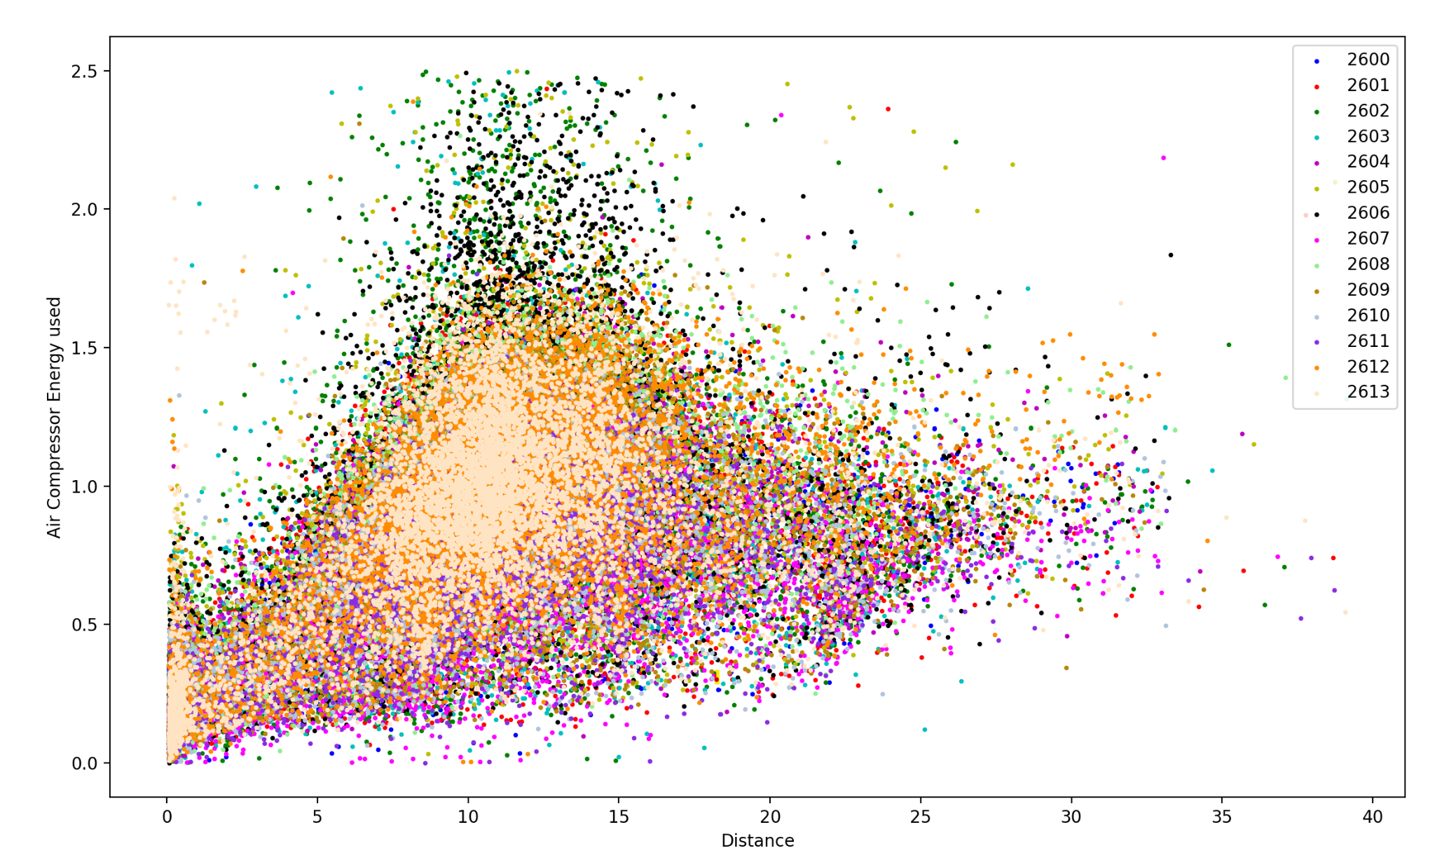
Our Solution - Data Analysis

Slide 10
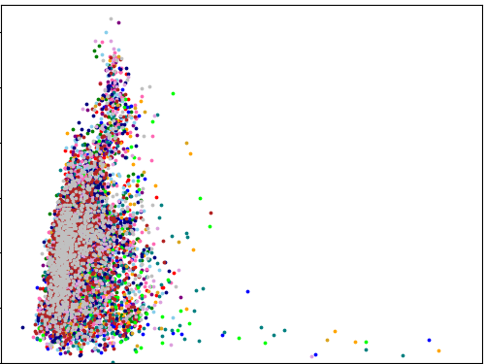
Attempting to remove outliers by setting minimum time driving

Slide 11
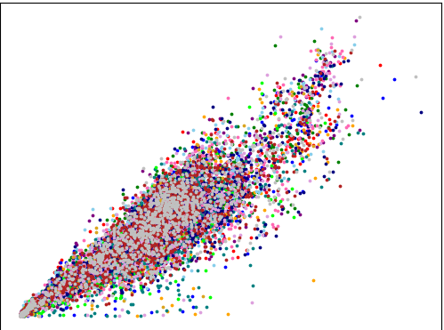
Attempting to remove outliers by setting minimum time driving

Slide 12
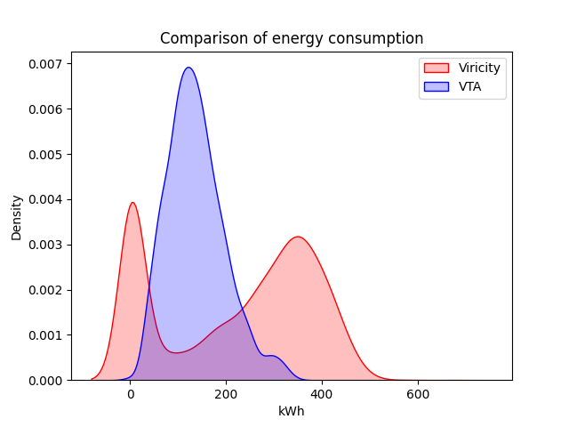
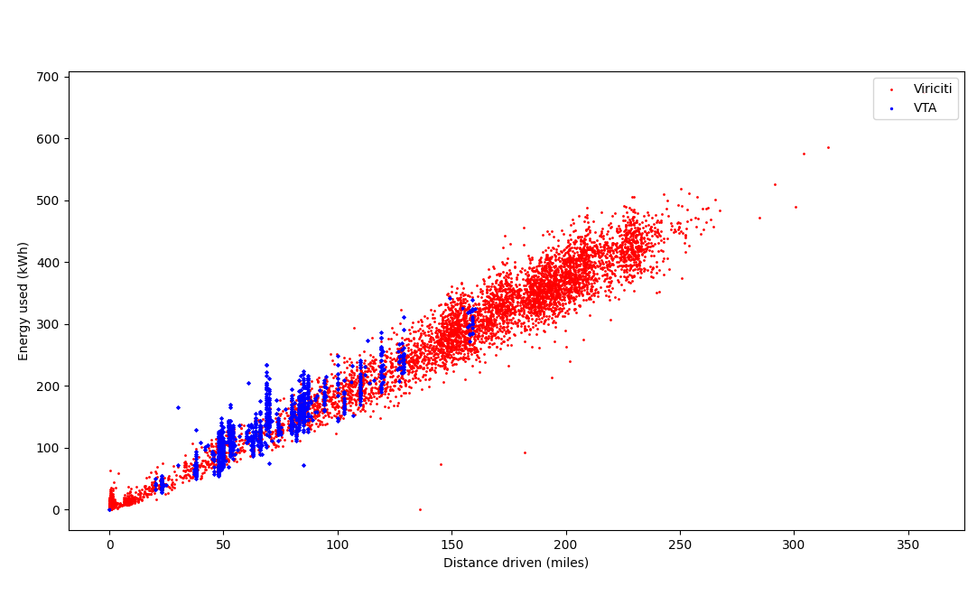
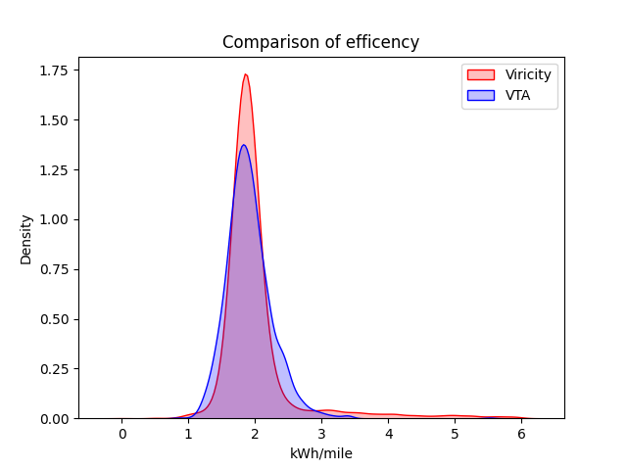
Comparisons between Viriciti and VTA data sets

Slide 13
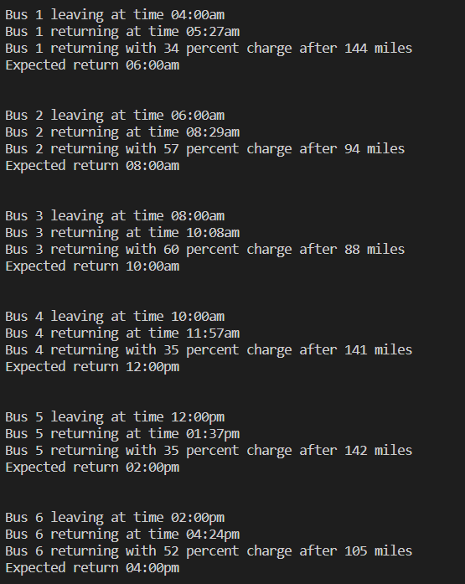
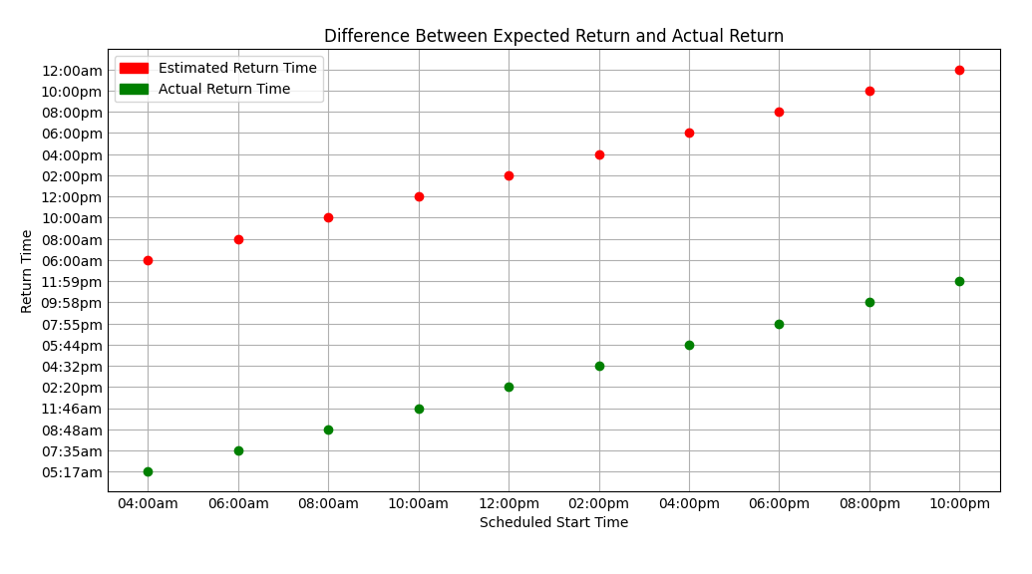
Our Solution - Simulation
Note: This plot is funky (see y-axis). Part of the simulation path forward is fixing this bug.
Notes:
The simulation I have been developing is a python file. I have build the file from scratch, so initial progress was slow. The simulation creates 10 bus objects, assigns them a random route distance, and calculates the percentage battery remaining when it returns based on this variable. The simulation prints some terminal code with the outputs seen and makes a scatter plot.

Slide 14

Our Solution - Simulation
Notes:
‘Live’ demo of the simulation

Slide 15

Accomplishments
Data Analysis: Was able to draw conclusions about relationships between variables and between the data sets
Data Analysis: Had some success filtering out outliers
Simulation: Created probability distributions to more accurately simulate miles driven and route duration
Simulation: Adjusted time formatting and standard deviation for trip durations
Simulation: Created an initial plot showing the difference between estimated arrival and actual arrival
Notes:
Image source: https://www.google.com/url?sa=i&url=https%3A%2F%2Fwww.pngitem.com%2Fmiddle%2FiJoiRw_1st-place-award-ribbon-clipart-free-clipart-images%2F&psig=AOvVaw1zcdG6sr1aQLA5OFjyDlQb&ust=1677889500182000&source=images&cd=vfe&ved=0CA4QjRxqFwoTCIiYrM6_vv0CFQAAAAAdAAAAABAE

Slide 16
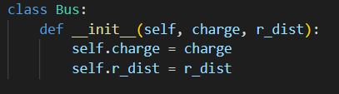
Path Forward - Simulation
Currently, we have charge and route distance. Route distance is based on the normal distribution for route distanced (50-150 miles)
Attributes to potentially add:
Driver
Weather
Scheduled departure/arrival times
Additionally, some of the times going from am to pm are printing incorrect values, so that will get debugged!
Notes:
The simulation solution that we currently have is very basic. Over the rest of this semester and likely most of next, I will be spending my time making the simulation more advanced. Enhancing the simulation will involve adding and updating various attributes, first of which will be a driver. The previous capstone group found data that indicated some drivers were much more efficient than others, so this attribute has impact on the battery levels of the buses.

Slide 17
Path Forward - Data Analysis
The next steps for the data analysis will focus on forecasting and supervised learning with the Python package scikit learn. This will allow us to predict the energy a bus will consume based on several other factors.
Other potential next steps include integrating the data with external data such as weather and combining the Viriciti and VTA datasets.

Slide 18
Path Forward - Simulation & Data Analysis
The ultimate goal for the simulation is to integrate it with the data analysis portion of the project. This will make a well-informed simulation that accurately reflects the true conditions VTA buses endure!
Notes:
Eventually, I will do more coordinated work with Matt and Aarushi to use their learning and implement it in the simulation.

Slide 19
Set Backs
A lot of learning (numpy, matplotlib, etc.)
Outliers and inaccurate data
Limited working experience in python
Making sure visuals are representing data accurately and clearly

